Slide 1
Test Slide Deck
IQR Objects Daniel Kaschek, IntiQuan 2021-10-15

Slide 2
Plain Slides

Slide 3
Just a test
Cars data set from R datasets
The data vie the speed of cars and distances taken to stop shown as plot

Slide 4
Slides with plots

Slide 5
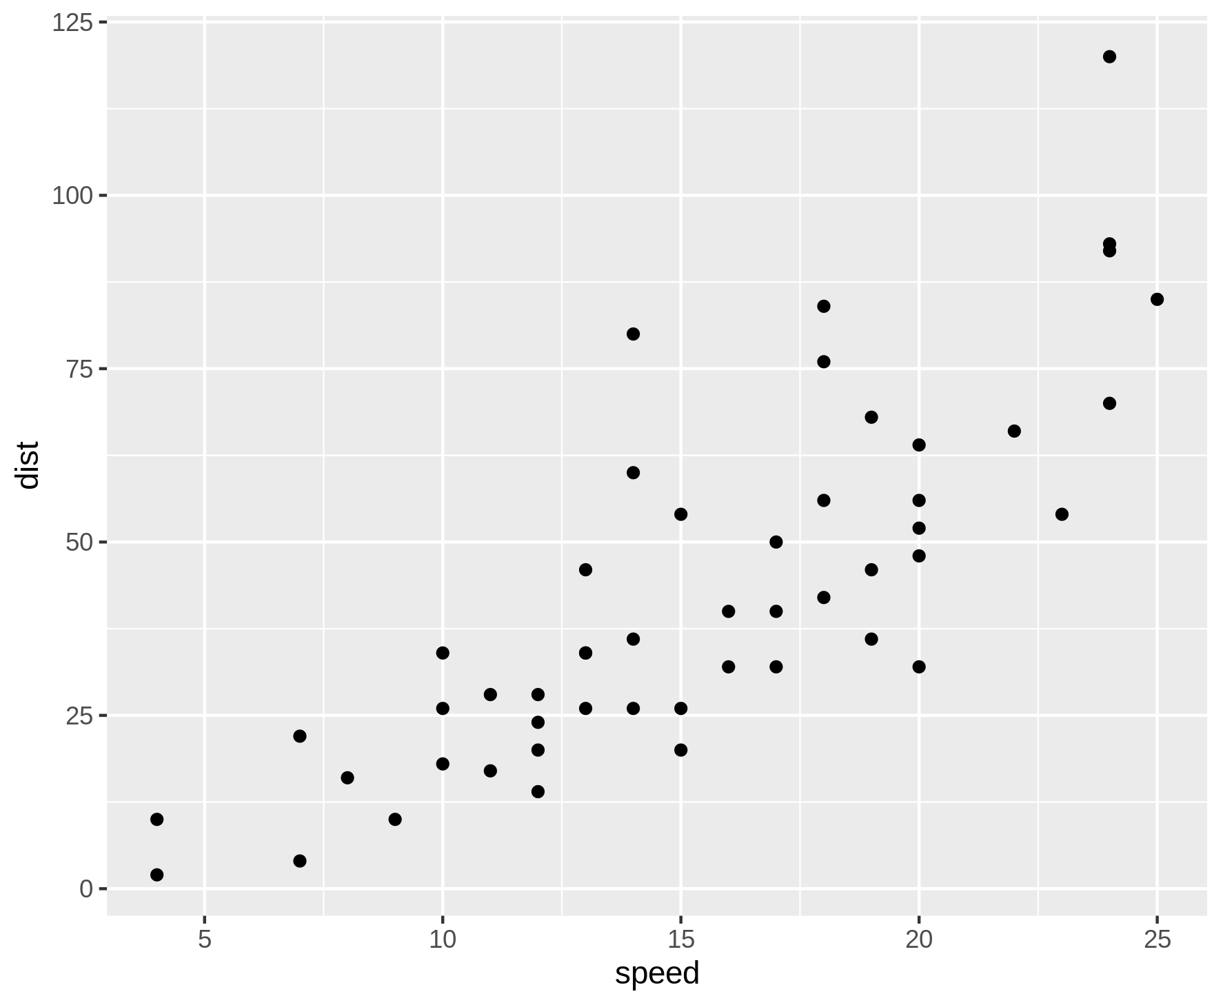
Overview of cars distance vs time to stop
Cars data set from R datasets
The data vie the speed of cars and distances taken to stop shown as plot
Source: Ezekiel, M. (1930) Methods of Correlation Analysis. Wiley.

Slide 6
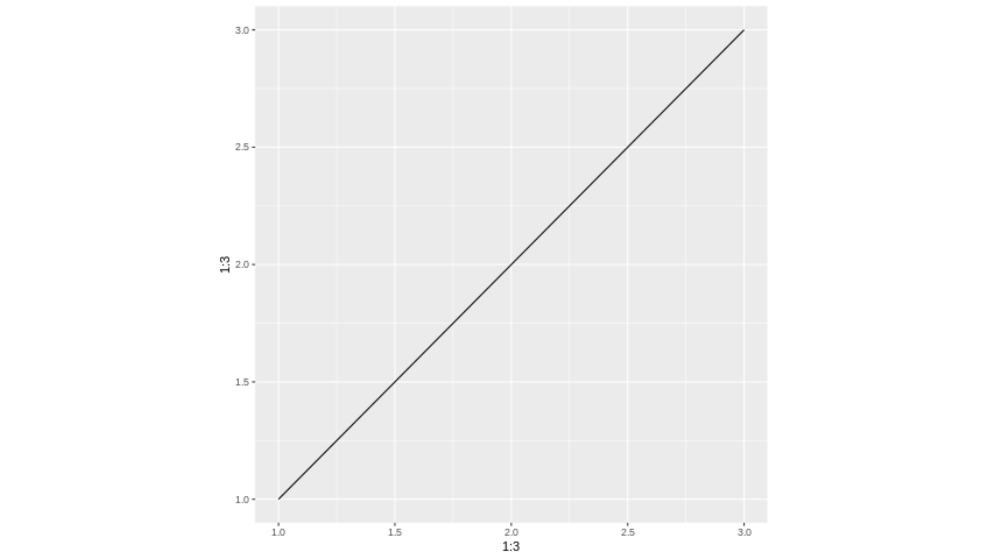
Plot from png file

Slide 7

Plot from pdf file

Slide 8
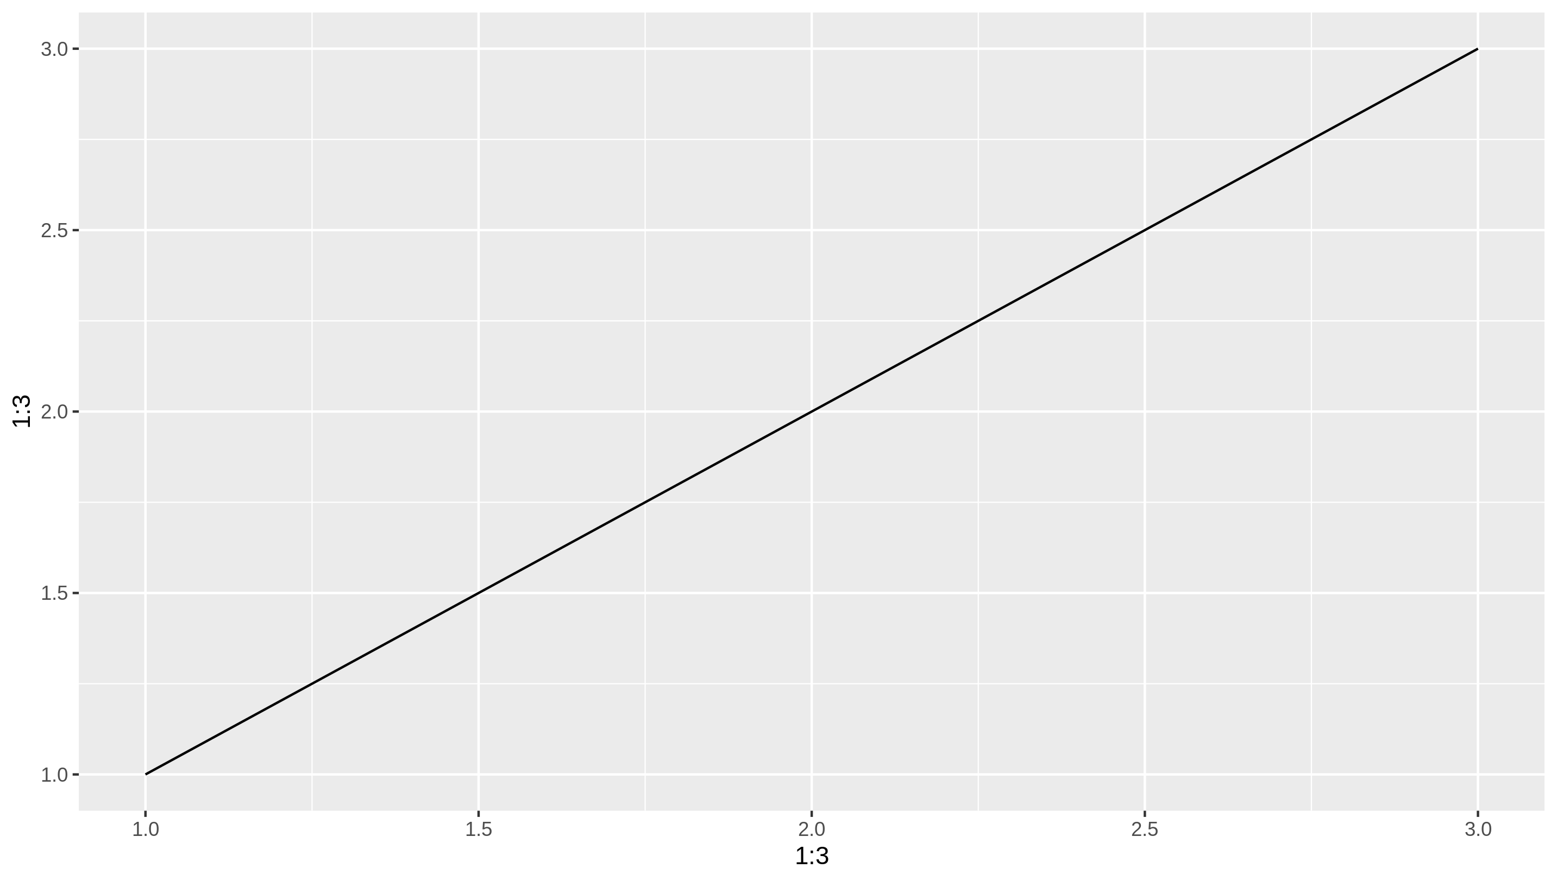
Plot from ggplot object

Slide 9
Slides with tables

Slide 10
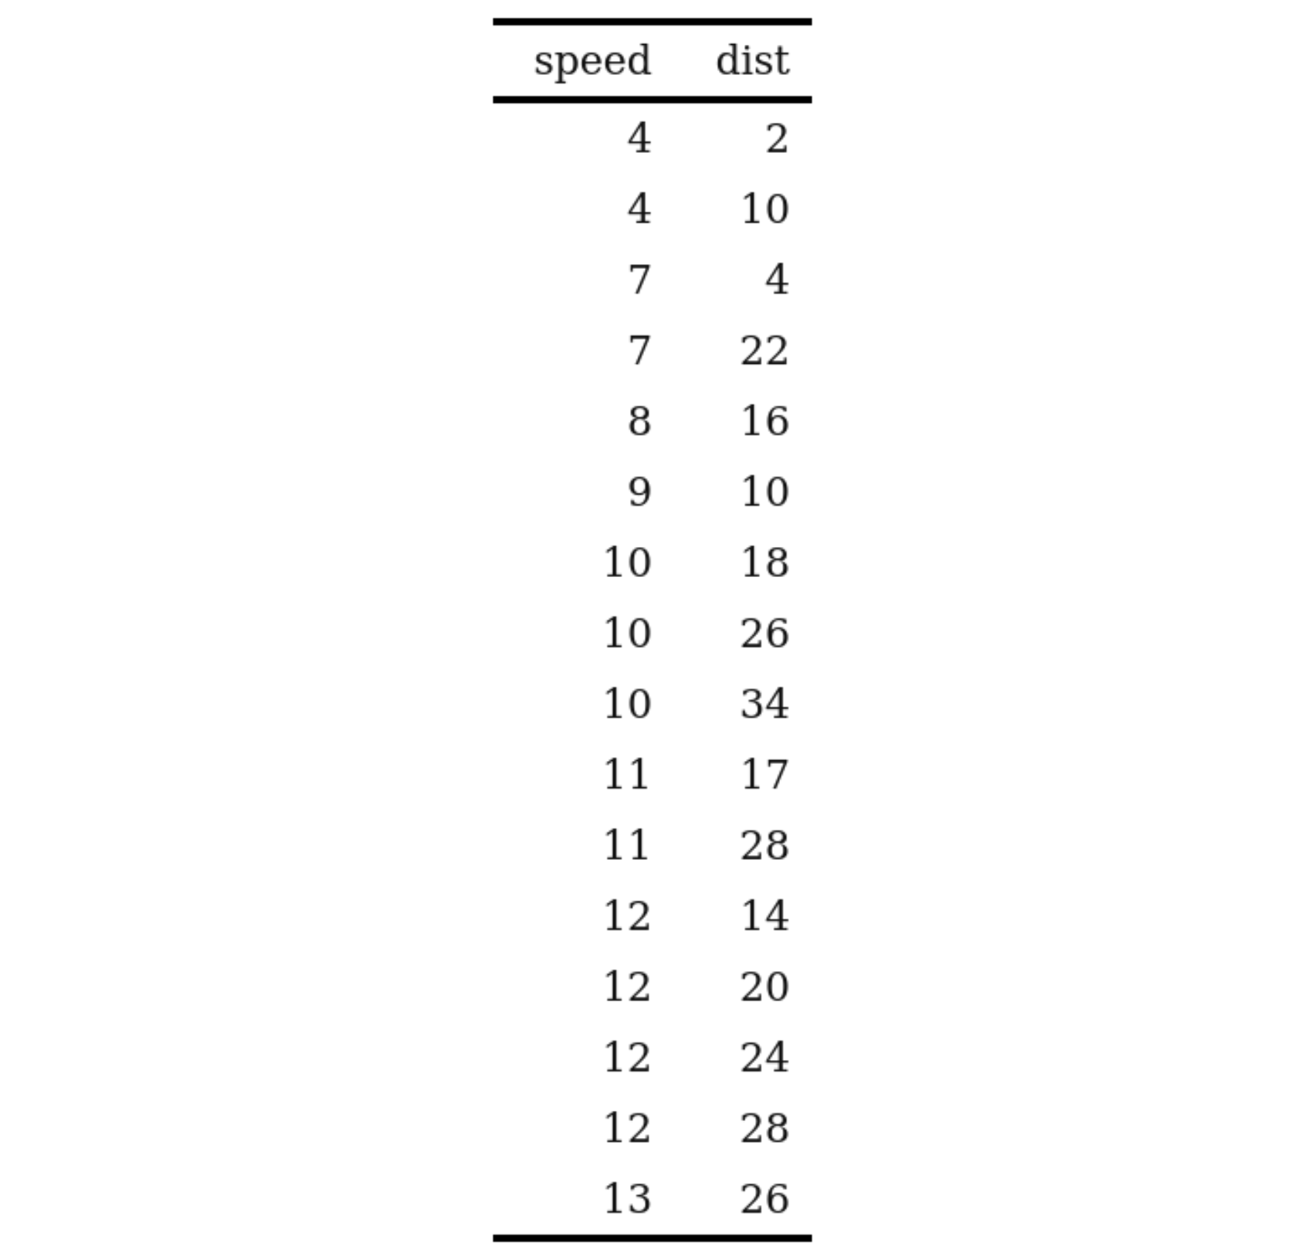
Overview of cars distance vs time to stop shown as table
Cars data set from R datasets
The data vie the speed of cars and distances taken to stop

Slide 11
Overview of cars distance vs time to stop shown as table
Bullet point with bold and italic
Another bullet point
Indented by two spaces
Another one
And back to really outer level
Some sort of formula E_{rel} = m*c²

Slide 12
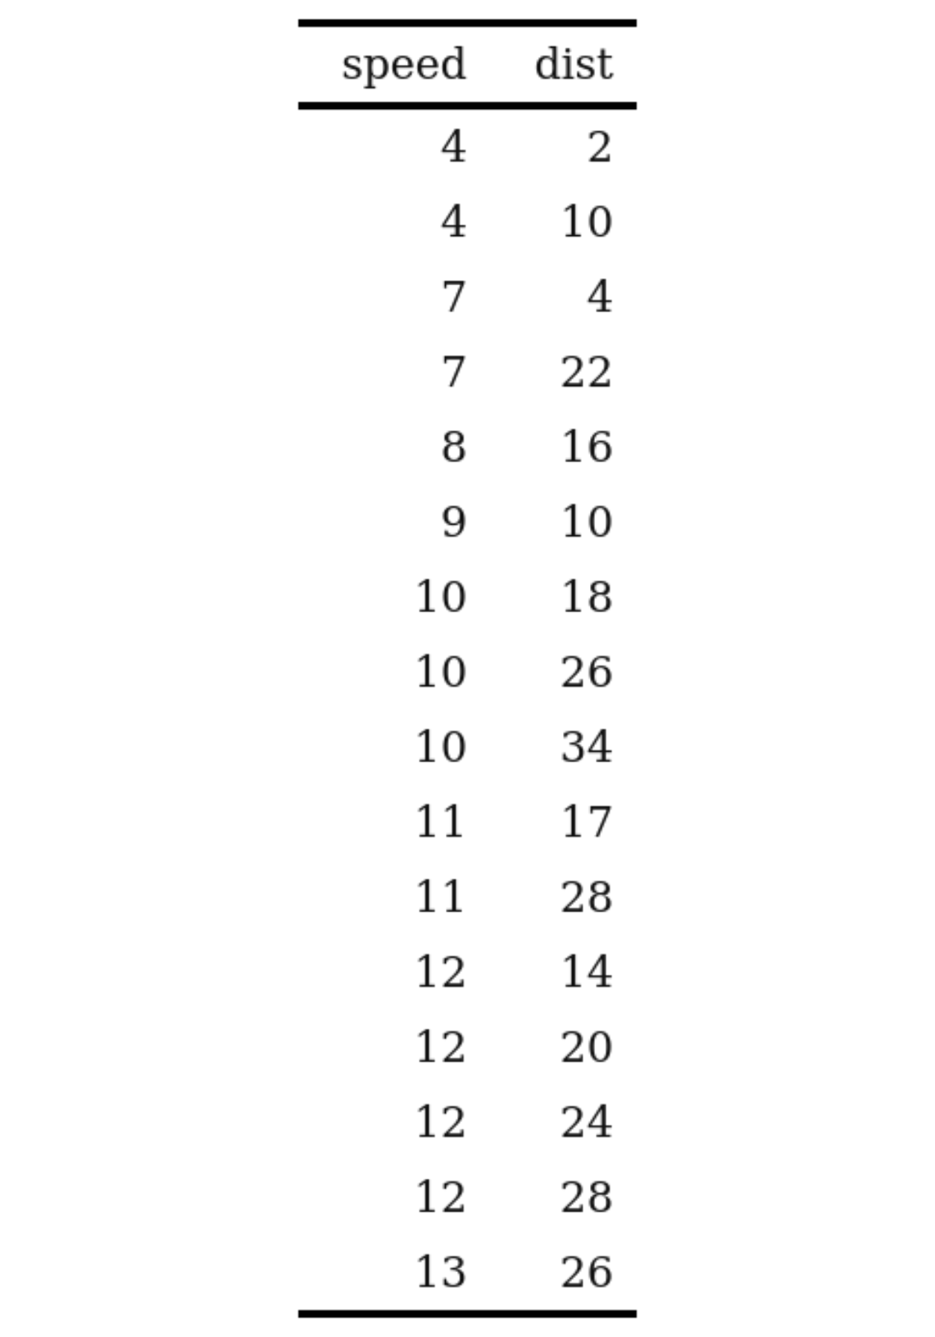
Overview of cars distance vs time to stop shown as table
Bullet point with bold and italic
Another bullet point
Indented by two spaces
Another one
And back to really outer level
Some sort of formula E_{rel} = m*c²

Slide 13
Test IQR Objects

Slide 14
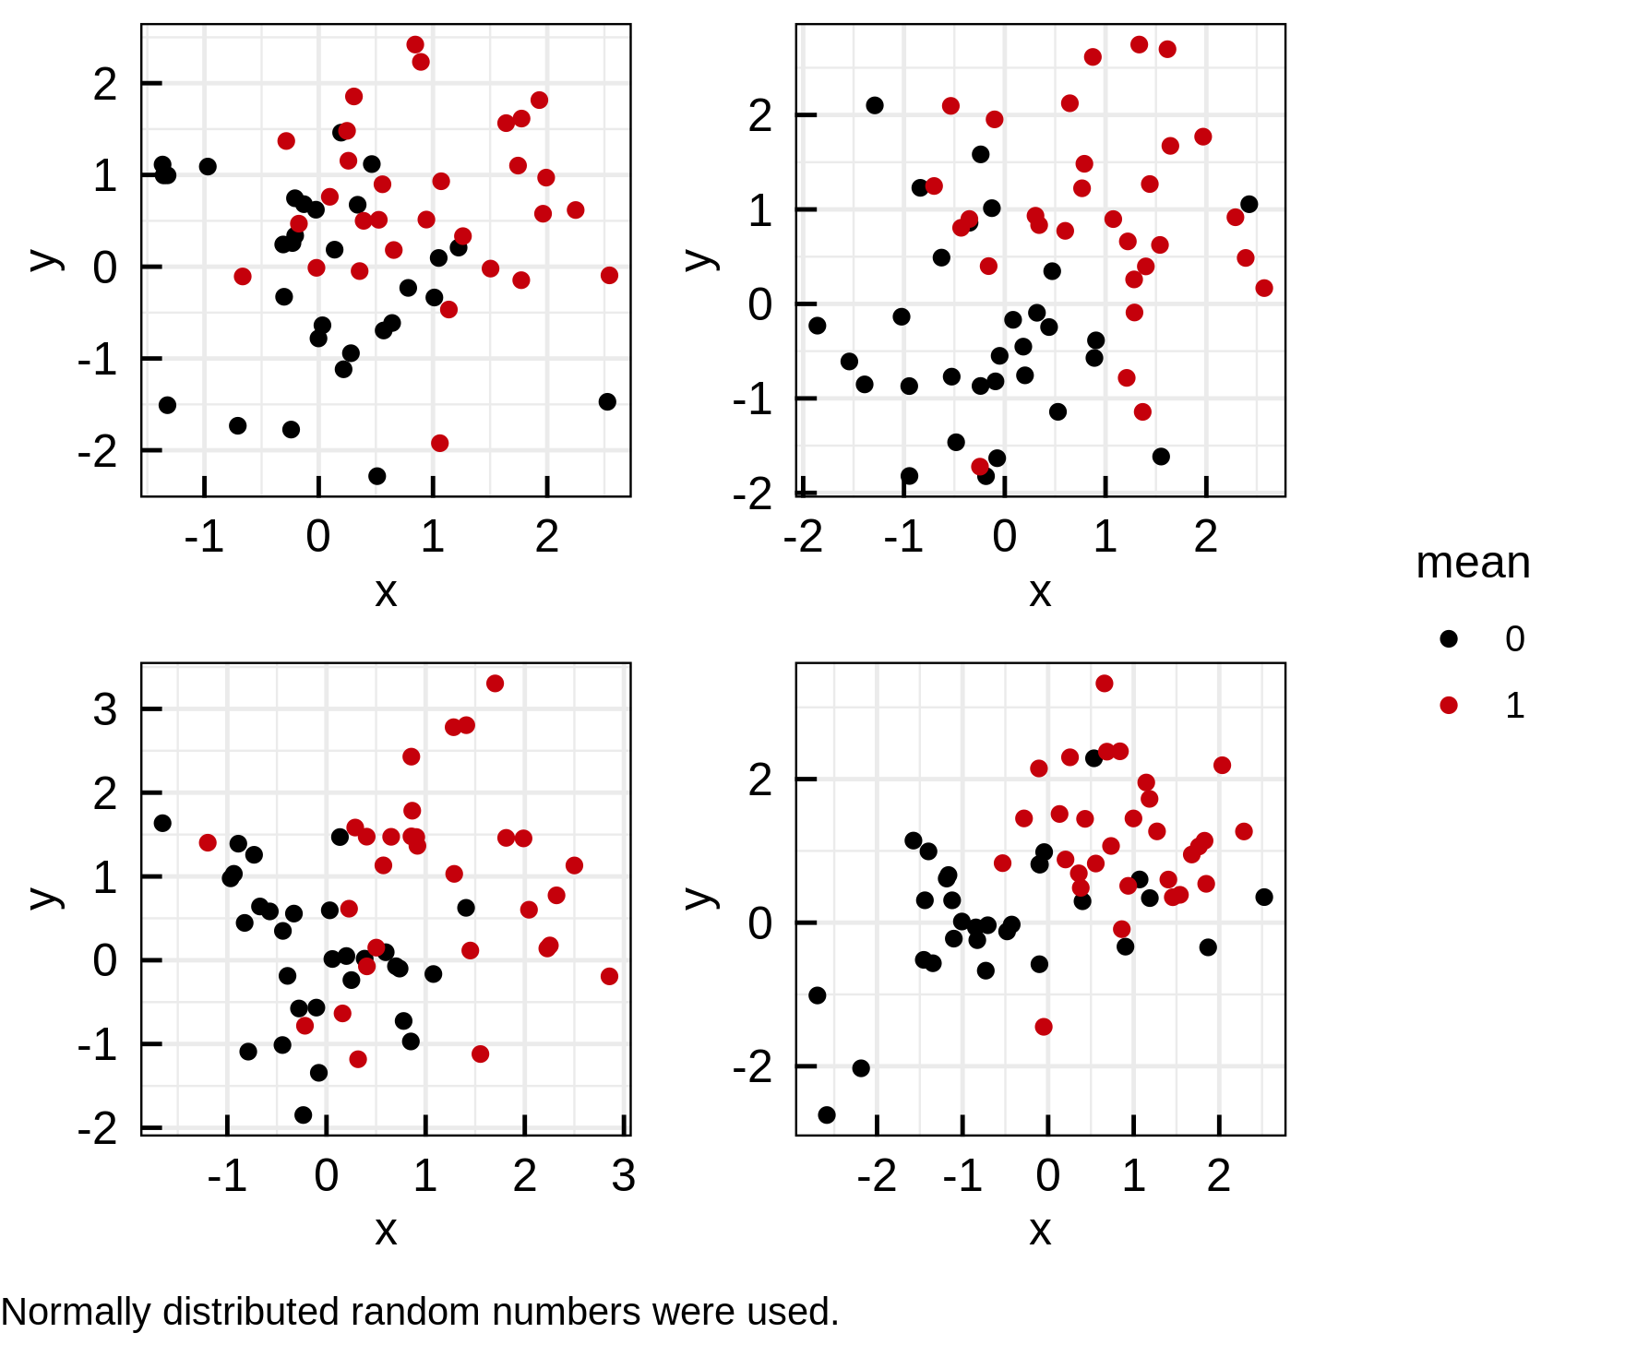
Plotting white noise (1)
A list of ggplot objects was created
Called IQRoutputFigure with arguments nrow, ncol, footer and filename
Called IQRoutputPPTX with bullet point list and IQRoutputFigure object.
File: ../Output/01_test/normal_distributions.pdf

Slide 15
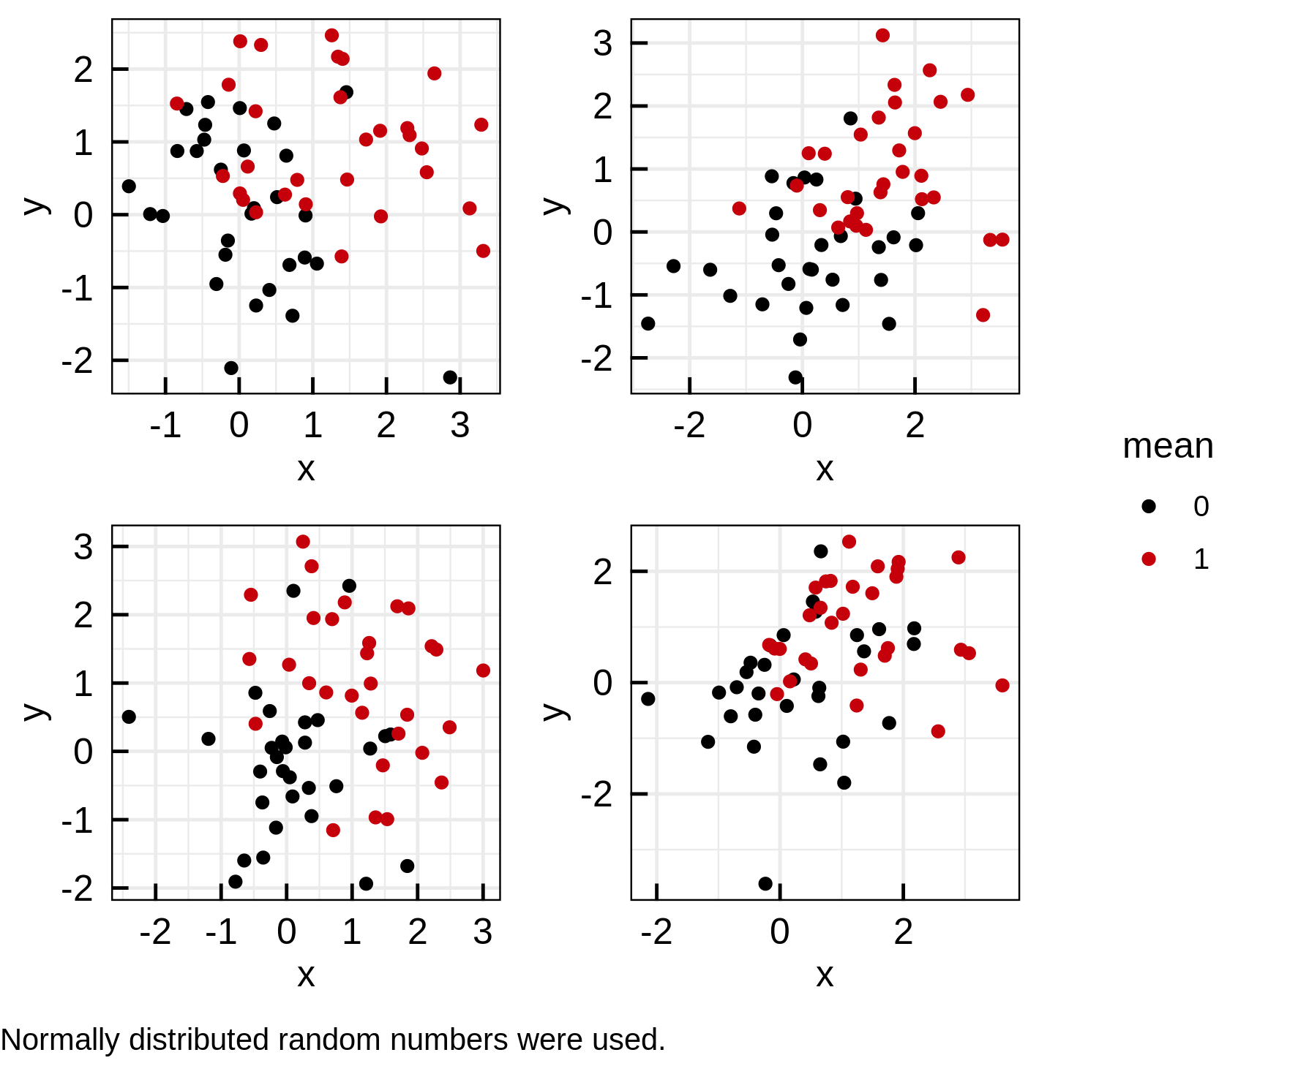
Plotting white noise (2)
A list of ggplot objects was created
Called IQRoutputFigure with arguments nrow, ncol, footer and filename
Called IQRoutputPPTX with bullet point list and IQRoutputFigure object.
File: ../Output/01_test/normal_distributions.pdf

Slide 16
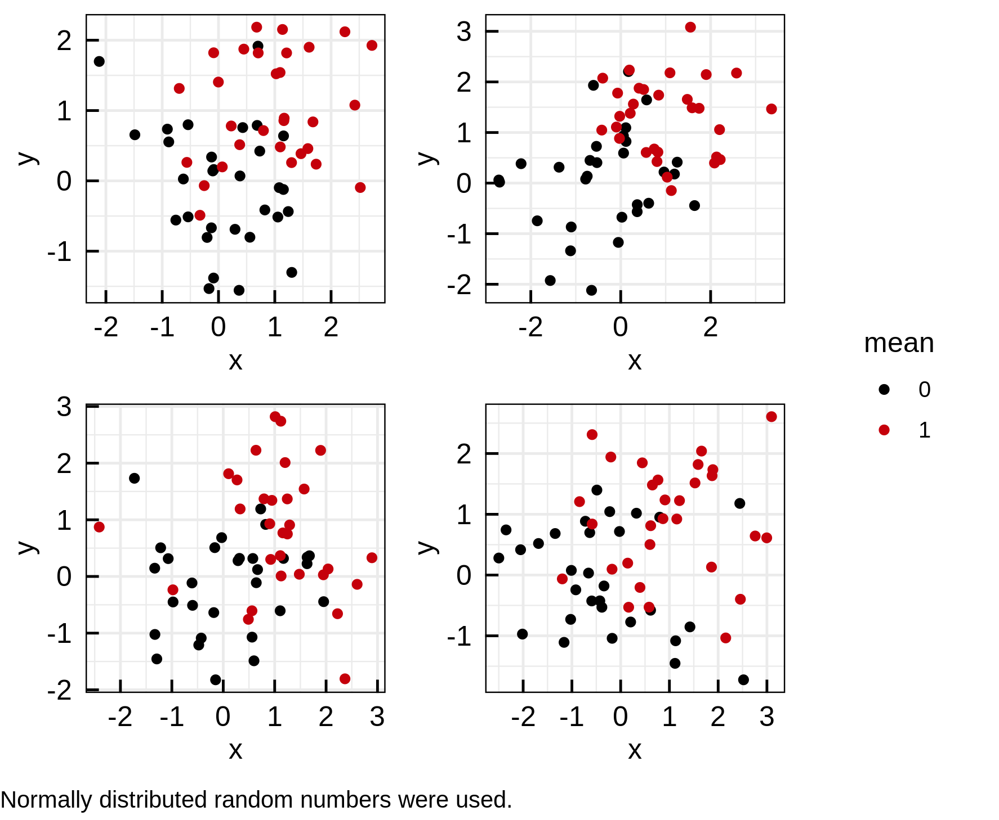
Plotting white noise (3)
A list of ggplot objects was created
Called IQRoutputFigure with arguments nrow, ncol, footer and filename
Called IQRoutputPPTX with bullet point list and IQRoutputFigure object.
File: ../Output/01_test/normal_distributions.pdf

Slide 17
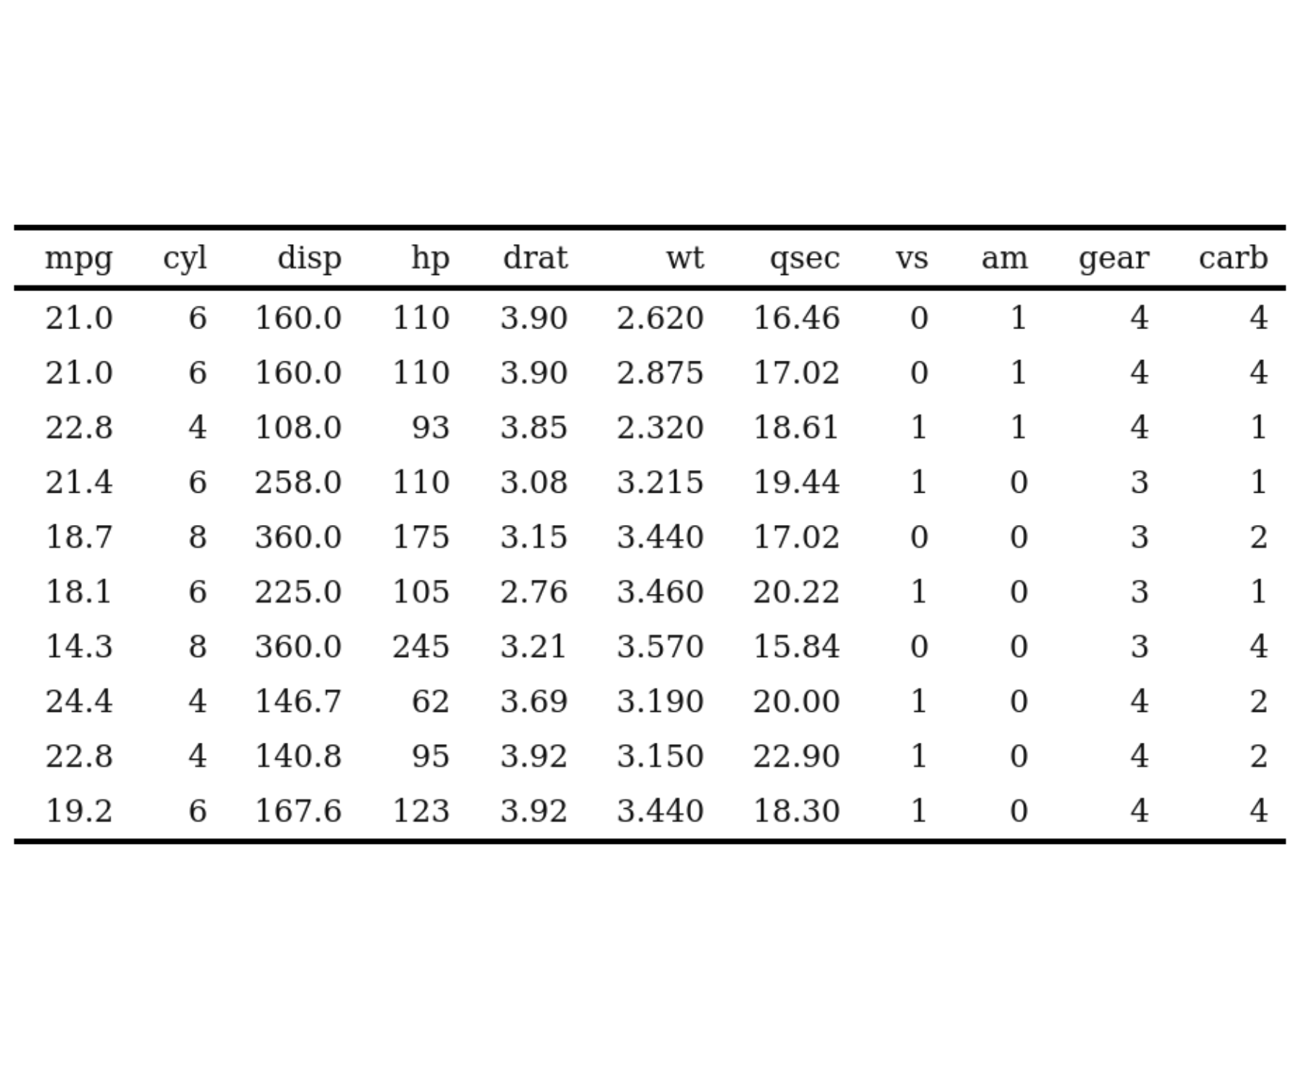
Well-known table
Used well known standard data set mtcars
Applied IQRoutputTable with arguments xfooter and filename
Called IQRoutputPPTX with bullet point list and IQRoutputTable object
See R datasets::mtcars File: ../Output/01_test/cars_table.txt

Slide 18
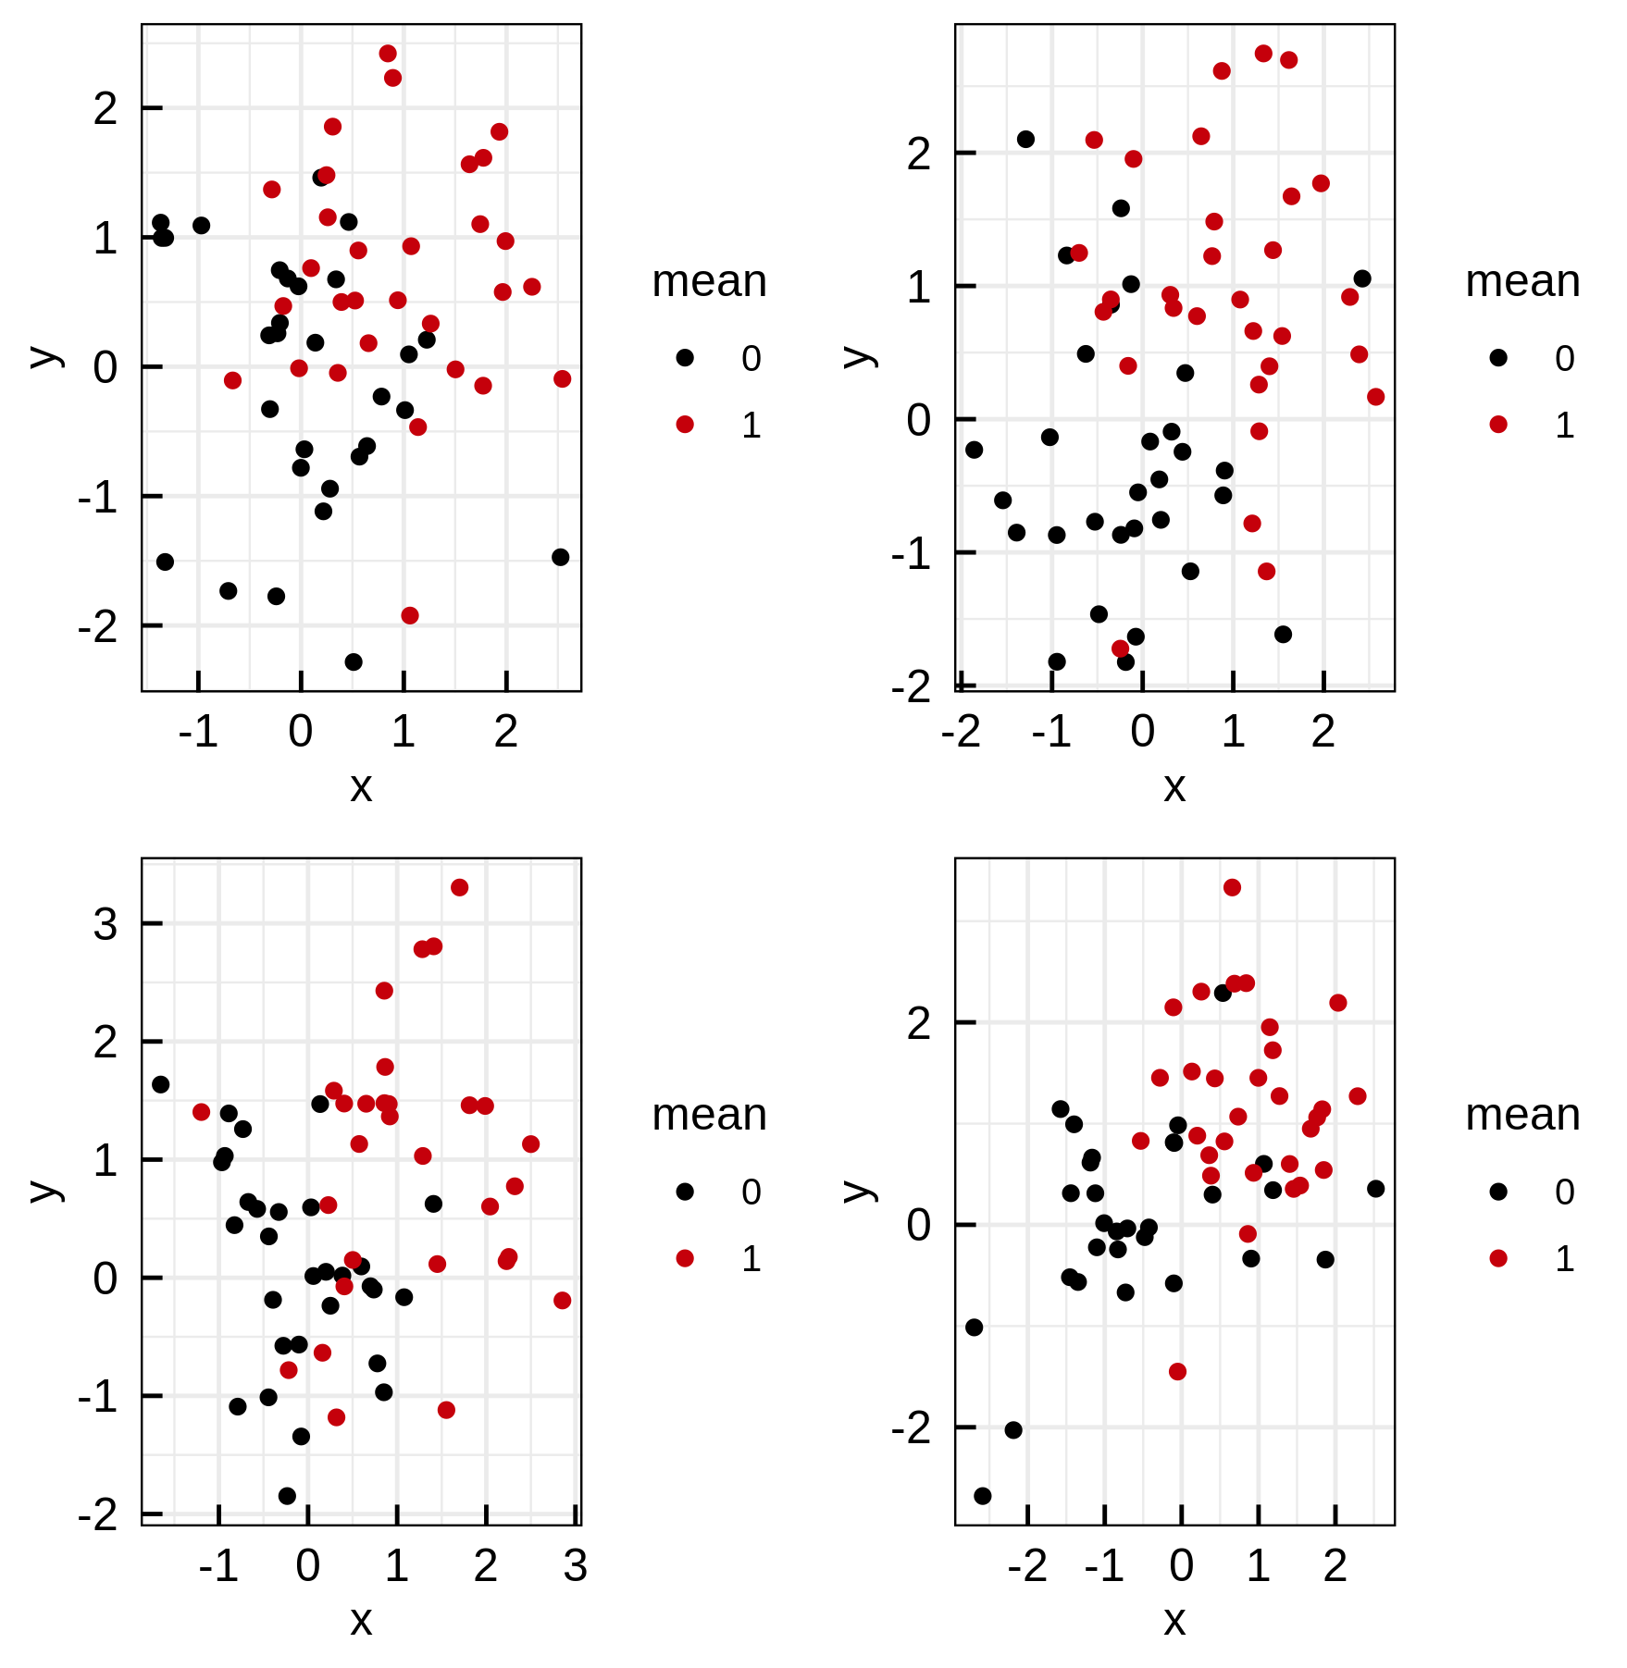
Plotting white noise and testing the wide title layout
File: ../Output/01_test/subset_normal_distributions.pdf

Slide 19
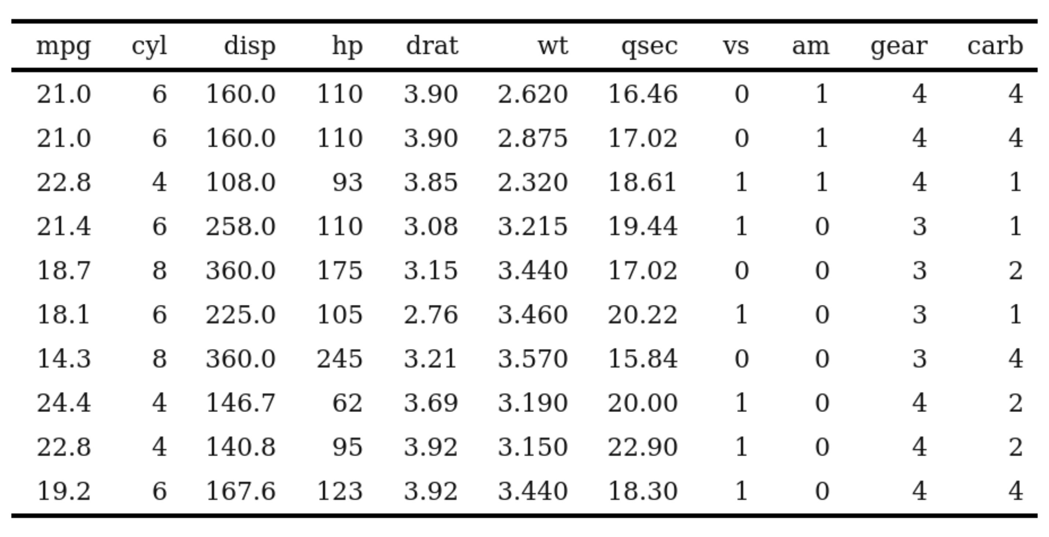
Cars data set
See R datasets::mtcars File: ../Output/01_test/cars_table.txt

Slide 20
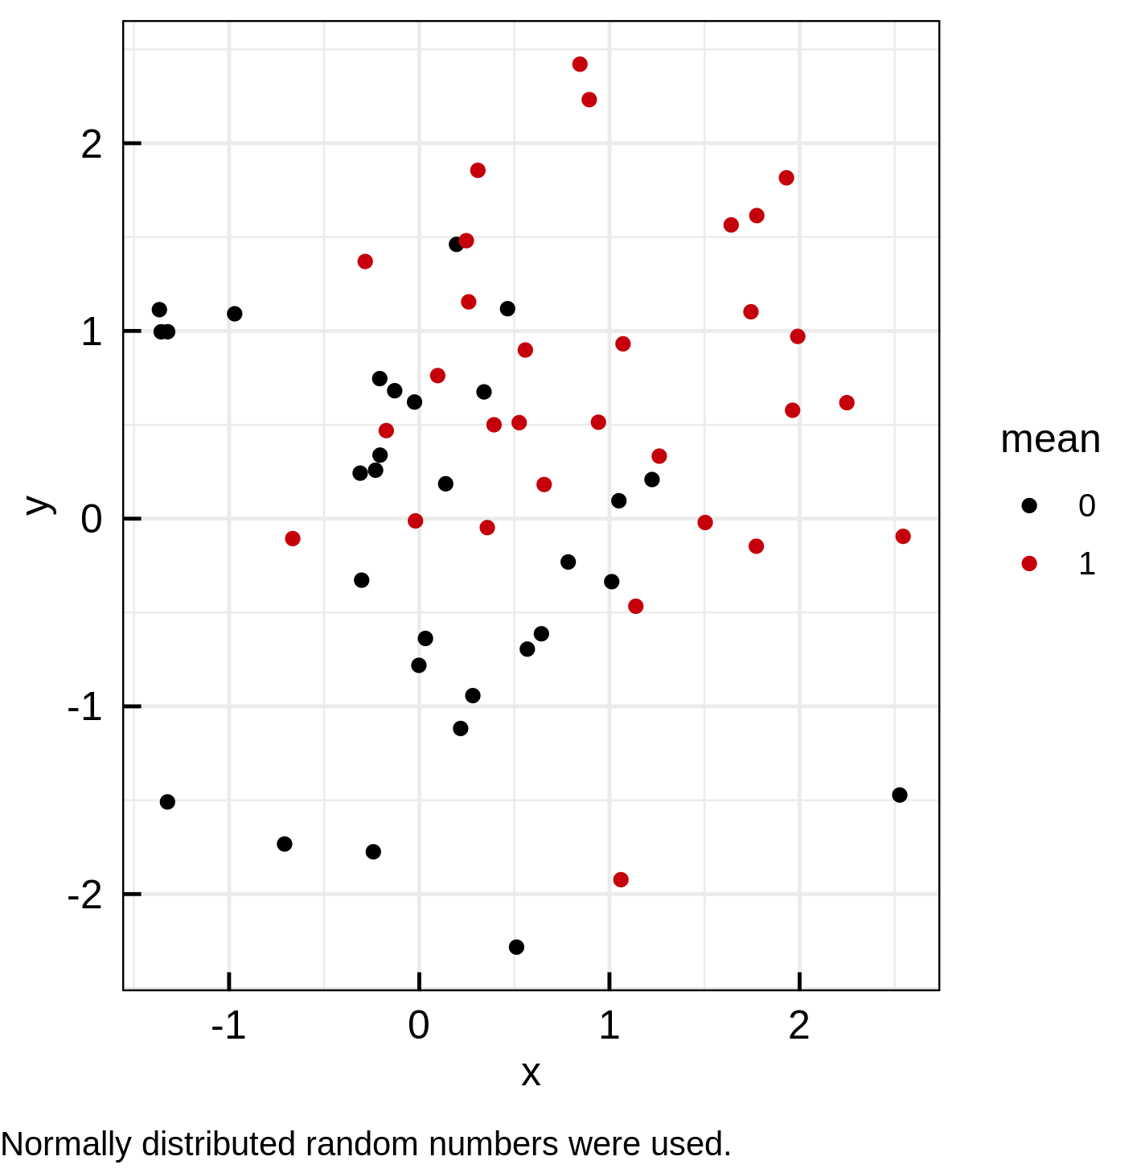
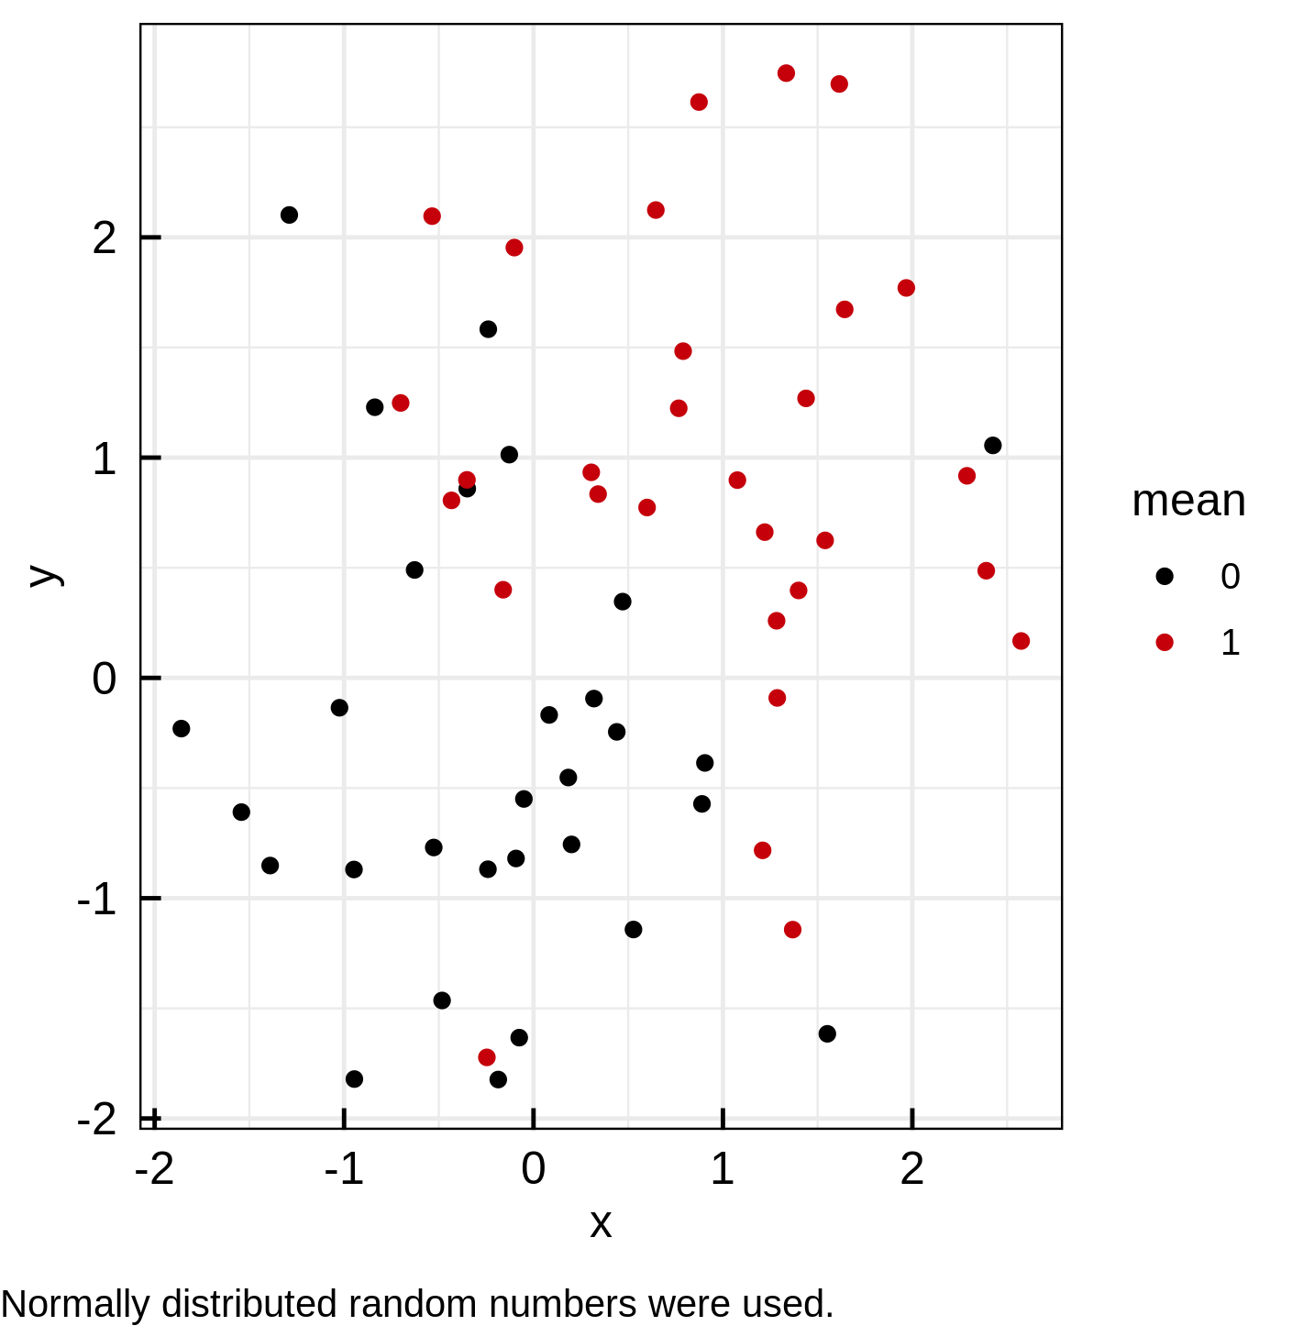
File: ../Output/01_test/normal_distributions_longlist.pdf
File: ../Output/01_test/normal_distributions_longlist.pdf

